Slide 1
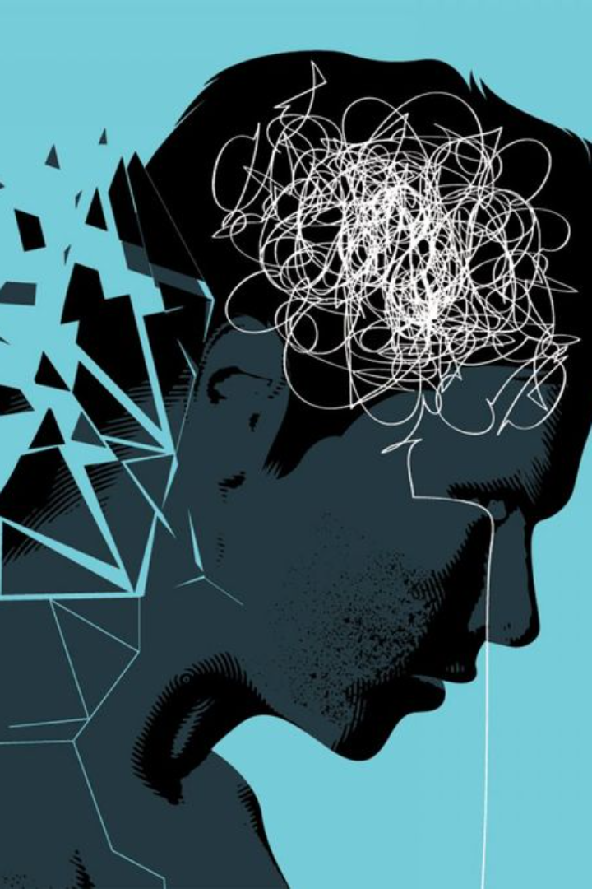
Mind Mate: Your Companion for Mental Wellness
Mind Mate is a comprehensive web and app platform designed to provide individuals seeking mental wellness support and resources with an array of innovative features. From emotion analysis integration to personalized support plans, daily check-ins, gamification for engagement, and much more, Mind Mate aims to offer a holistic and personalized approach to mental well-being.

Slide 2
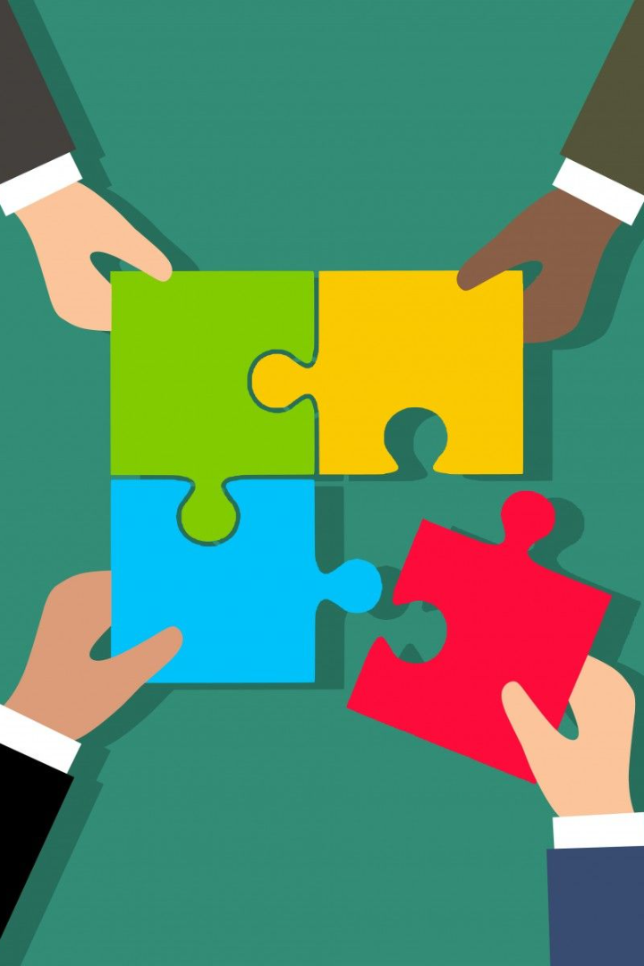
Team Behind Mind Mate (BERLIN)
SHIVAM - MAIT (IT- 2ND YEAR)
RITIK RAJ - MAIT (IT- 2ND YEAR)
DEEPAK PAL - MAIT (IT- 2ND YEAR)
RASHIKA - MAIT (IT- 2ND YEAR)

Slide 3
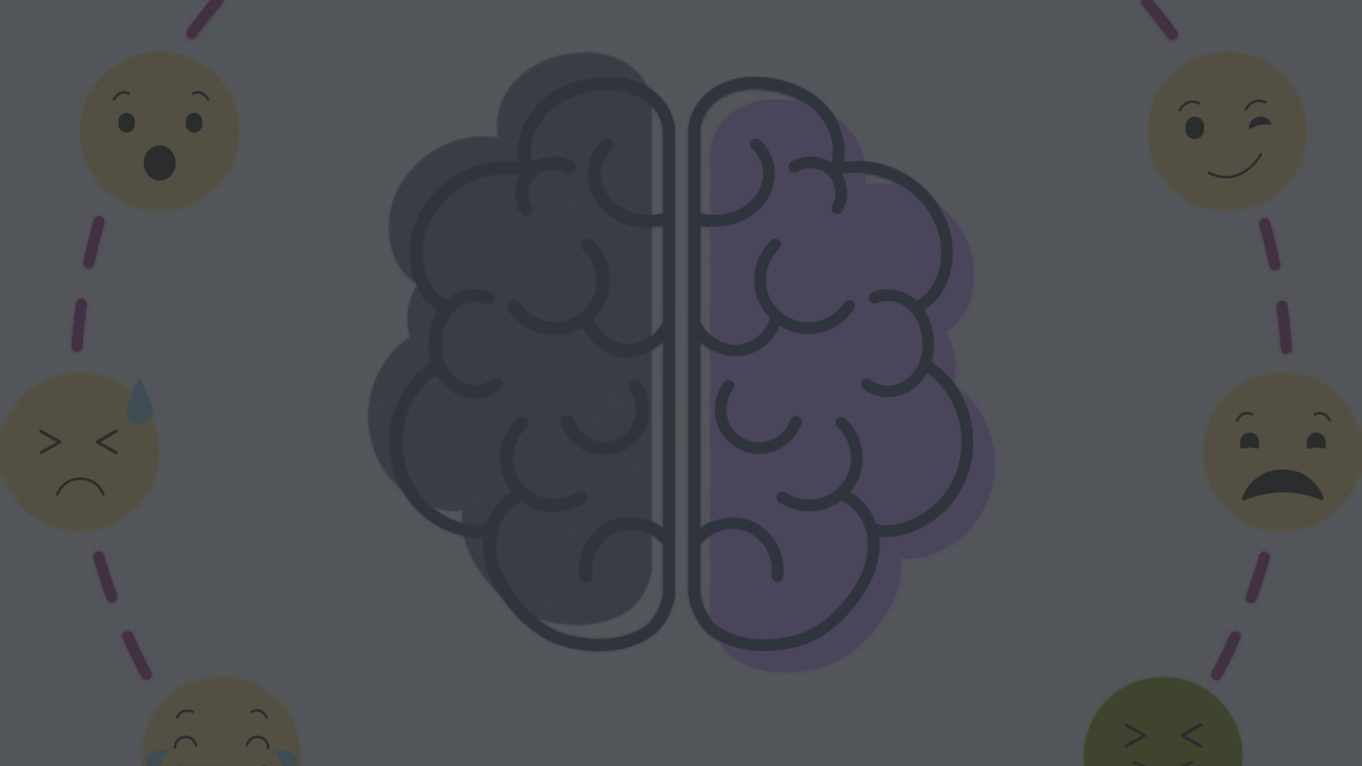
Emotion Analysis Integration.
Deep Understanding
Personalization
By integrating advanced emotion analysis tools, Mind Mate seeks to achieve a deeper understanding of the user's emotional state. This includes sentiment analysis, tone recognition, and facial expression analysis in video or voice interactions.
The integration will enable the platform to provide personalized support plans and resources based on the user's emotional needs, creating a more tailored and effective user experience.

Slide 4

Personalized Support Plans
1
Coping Strategies
2
Mindfulness Exercises
3
Resource Recommendations
The platform creates personalized mental health support plans that include coping strategies tailored to each user's unique needs and challenges.
Users receive mindfulness exercises that are specifically curated to address their emotional well-being and promote mental resilience.
Additionally, the plans include recommendations for various mental health resources such as articles, podcasts, and videos, providing comprehensive support for users.

Slide 5

Daily Check-ins
1
Regular Engagement
Mind Mate includes a feature for daily check-ins, reaching out to users to ask about their well-being, providing positive affirmations, and delivering motivational messages to foster a sense of regular engagement and support.

Slide 6

Integration with Mental Health Resources
Expanded Resource Database
Mind Mate aims to expand its resource database to provide a comprehensive array of mental health resources, including articles, videos, podcasts, and links to reputable mental health organizations.

Slide 7
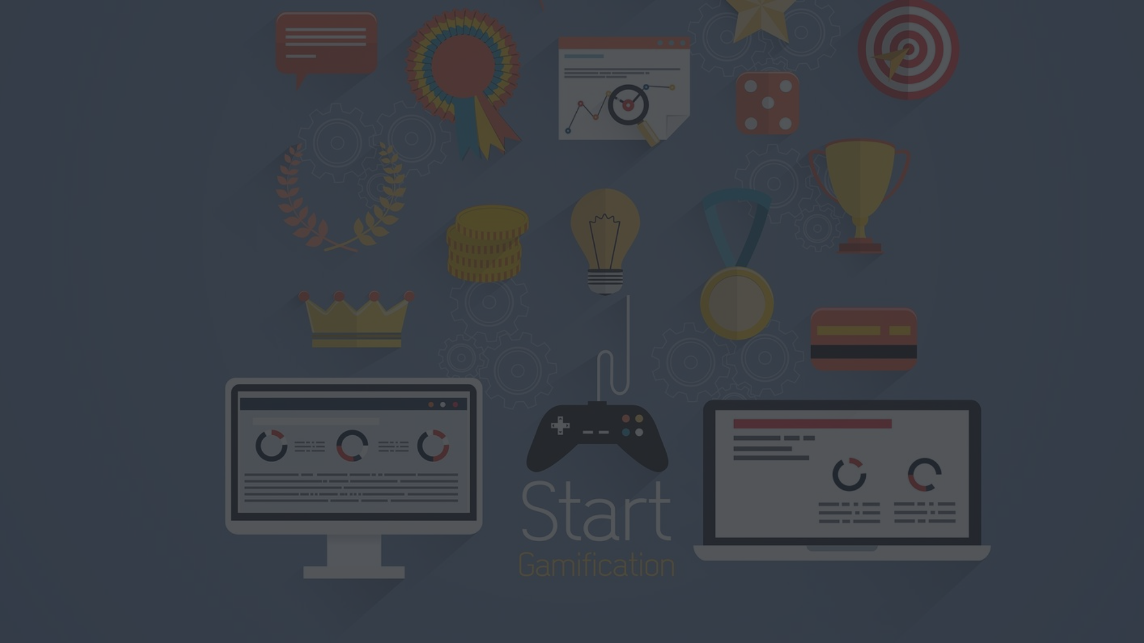

Gamification for Engagement
Encouraging Engagement
Mind Mate incorporates gamification elements to encourage user engagement, offering challenges, achievements, and rewards for completing mental health exercises and reaching personal milestones.

Slide 8

Community Support
Accessible Connections
Moderation for Safety
Within the Mind Mate platform, users can connect, share experiences, and provide support, fostering an inclusive and empowering community environment.
Mind Mate ensures moderation to maintain a safe and positive environment within the community forum or group, prioritizing the well-being of its users.

Slide 9

Integration with Wearables
Health Insights
Mind Mate allows users to connect their health and fitness wearables to gain additional insights into their well-being, such as sleep patterns and activity levels, enhancing the overall support experience.

Slide 10
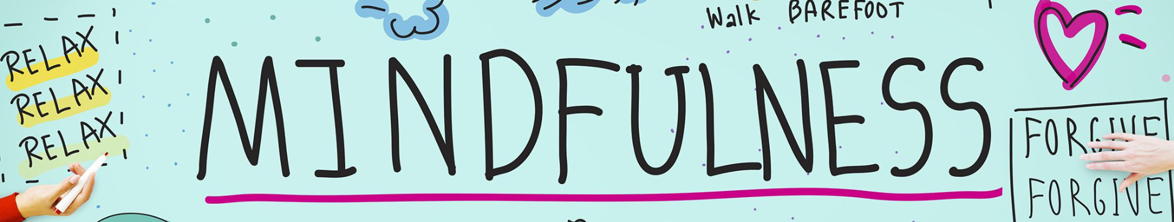
Mindfulness and Relaxation Exercises
1
Guided Exercises
Enhancing the platform with guided mindfulness and relaxation exercises, Mind Mate offers breathing exercises, guided meditations, and calming visualizations to promote mental well-being.

Slide 11
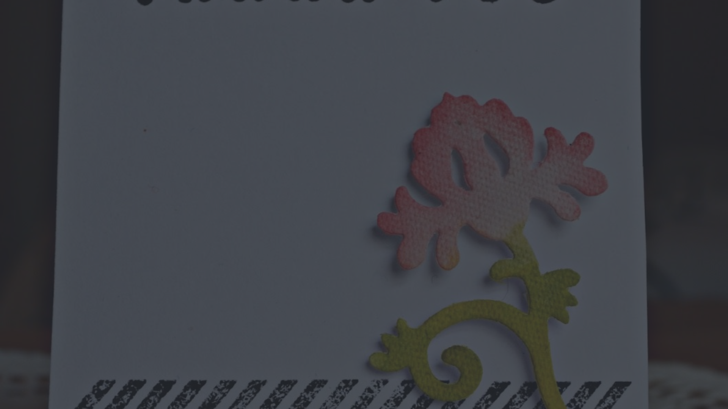
THANK YOU

